Slide 1
LDRs and Processing

Slide 2
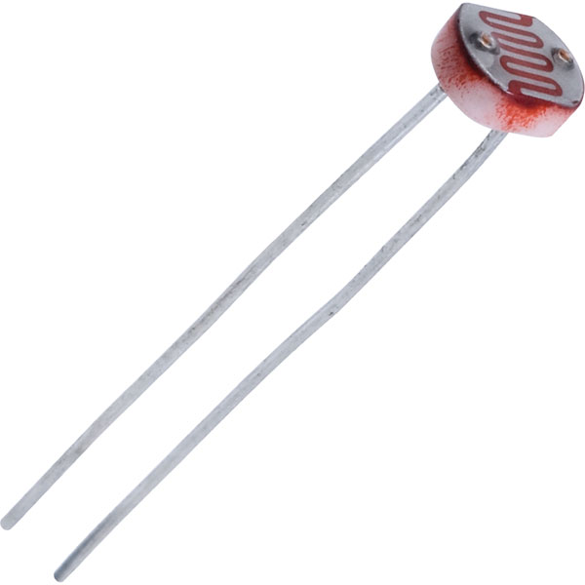
Light Dependent Resistor
A resistor reduces current.
Resistance is measured in ohms
An LDR has a resistance dependent on the intensity of light shining on it.

Slide 3
Processing
https://processing.org/
Processing is derived from Java, an interpreted, object orientated language.
Processing is designed for Artists and Designers
It is focused on graphics and ease-of-use

Slide 4
Graphics on computers work by “drawing” a new image every frame.
Every frame, everything is erased and a new image is drawn.
When the frames are fast enough, we perceive continuous movement.

Slide 5
The Plan
Change the size of a circle based on the light level.

Slide 6
1. Monitor resistance of LDR 2. Send the resistance value to a laptop via serial. 3. Draw a circle whose diameter is proportional to the resistance value.

Slide 7
https://github.com/landsquid9/code-electronics-workshops/tree/master/lesson_3

Slide 8
Processing Code
import processing.serial.*;

Slide 9
Serial myPort; boolean portConnected; int readingInt = 0; float readingFloat = 0.0; float ellipseSize = 0; float ellipseMaxSize = 256;

Slide 10
void setup()
{
// the following
// code goes here
}

Slide 11
printArray(Serial.list());

Slide 12
if(Serial.list().length > 0)
{
myPort = new Serial(this, Serial.list()[0], 9600);
portConnected = true;
}

Slide 13
else
{
portConnected = false;
}

Slide 14
size(1024, 768);

Slide 15
void draw()
{
// The following code
// goes here
}

Slide 16
clear();

Slide 17
if(portConnected)
{

Slide 18
if(myPort.available() > 0)
{
readingInt = myPort.read();
readingFloat = readingInt;
}

Slide 19
print(readingFloat);
print(" ");

Slide 20
ellipseSize = (readingFloat / 256) * ellipseMaxSize;
println(ellipseSize);

Slide 21
ellipse(width/2, height/2, ellipseSize, ellipseSize);

Slide 22
else
{
ellipse(width/2,
height/2,
80, 80);
}

Slide 23
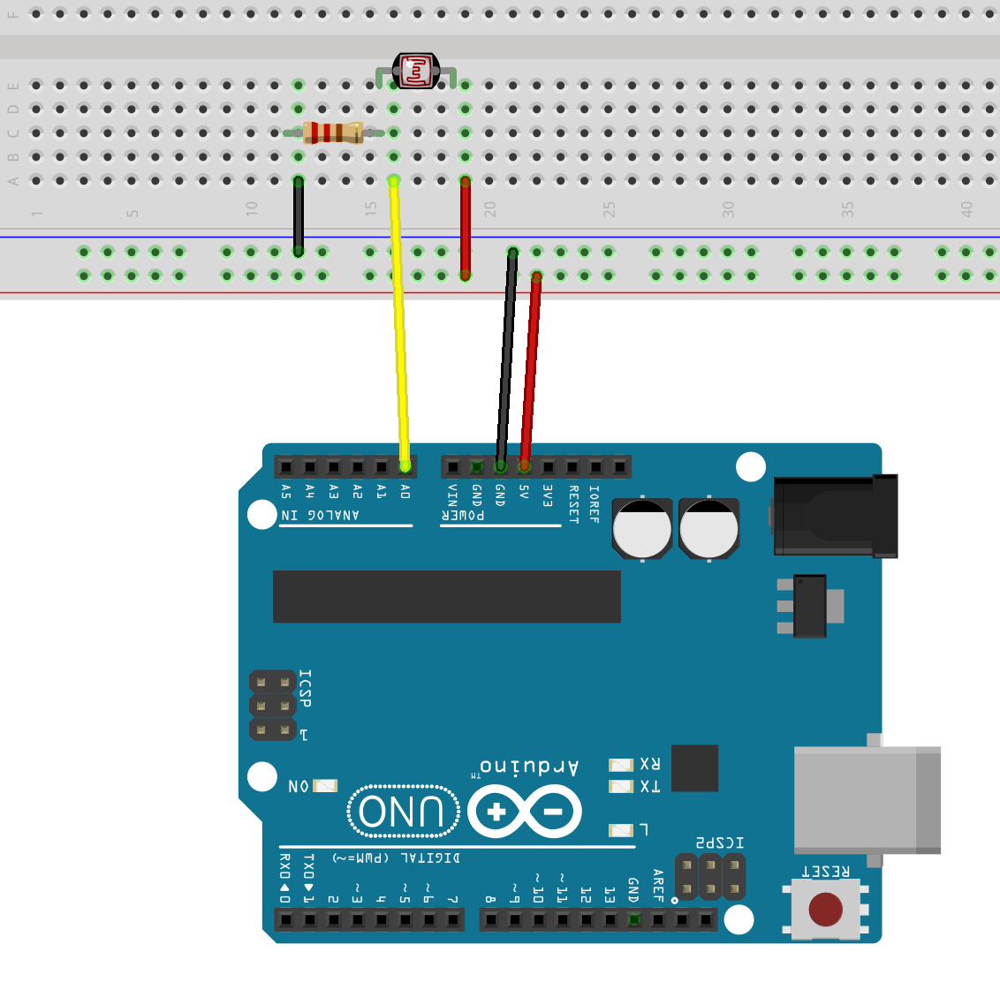

Slide 24
const int ldrPin = A0;
int readingInt = 0;
byte readingByte = 0;

Slide 25
void setup()
{
Serial.begin(9600);
}

Slide 26
void loop()
{
// The following code
// goes here
}

Slide 27
readingInt = analogRead(ldrPin);
readingByte = readingInt / 4;

Slide 28
Serial.write(readingByte);
delay(100);

